Slide 1
Introduction to RAG
Liad Magen

Slide 2

Agenda
RAG Strategies and benefits
Implementing RAG with OpenAI APIs
Creating a basic RAG enabled agent

Slide 3
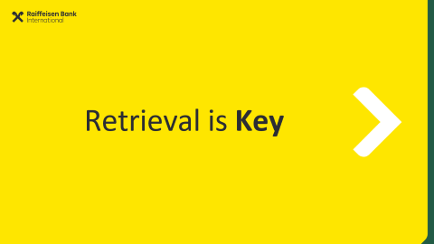
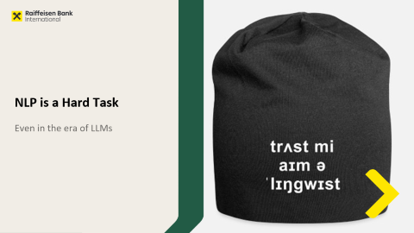
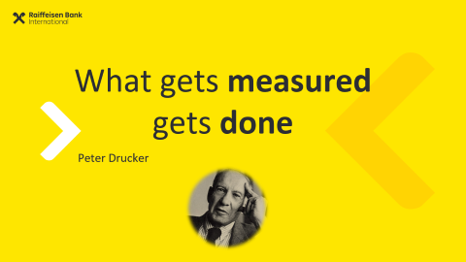
Agenda

Slide 4
End of Day
Reflection

Slide 5
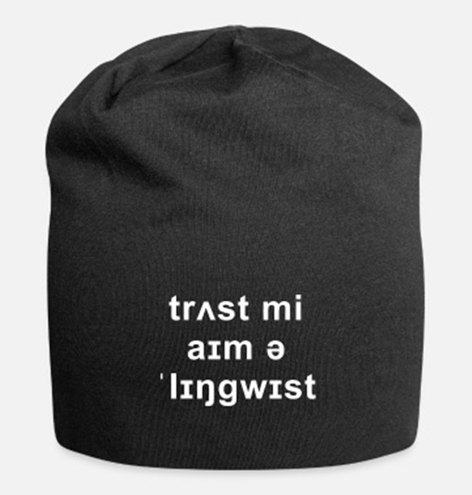
NLP is a Hard Task
Even in the era of LLMs

Slide 6
Why is NLP hard?
!
Negativity & Restrictiveness
Meaning
Ambiguity
Variability
Language

Slide 7
Variability
Lexical
I loooooove it! everytime → every time oscar nom’d doc → Oscar-nominated documentary is bananas → is great
2m 2ma 2mar 2mara 2maro 2marrow 2mor 2mora
2moro 2morow 2morr 2morro 2morrow 2moz 2mr
2mro 2mrrw 2mrw 2mw tmmrw tmo tmoro tmorrow
tmoz tmr tmro tmrow tmrrow tmrrw tmrw tmrww tmw
tomaro tomarow tomarro tomarrow tomm
tommarow tommarrow tommoro tommorow
tommorrow tommorw tommrow tomo tomolo tomoro
tomorow tomorro tomorrw tomoz tomrw tomz

Slide 8
Variability
Semantical / Pragmatical
He acquired it He purchased it He bought it It was bought by him It was sold to him She sold it to him She sold him that

Slide 9
Negativity & Restrictiveness
Martin is a Data Scientist
Martin is not a data Scientist
Martin is a great Data Scientist
Martin is not a great data scientist
Martin is not a Data Scientist
Martin is not a Mad Scientist

Slide 10
Negativity and Restrictiveness
David was not the CEO
of Microsoft
from 2005
to 2010

Slide 11
Real-World Knowledge
Winograd Schema Challenge:
The trophy didn’t fit in the bag because it was too small The trophy didn’t fit in the bag because it was too big
The city councilmen refused the demonstrators a permit because they feared violence. The city councilmen refused the demonstrators a permit because they advocated violence.
The man couldn’t lift his son because he was too weak The man couldn’t lift his son because he was too heavy

Slide 12
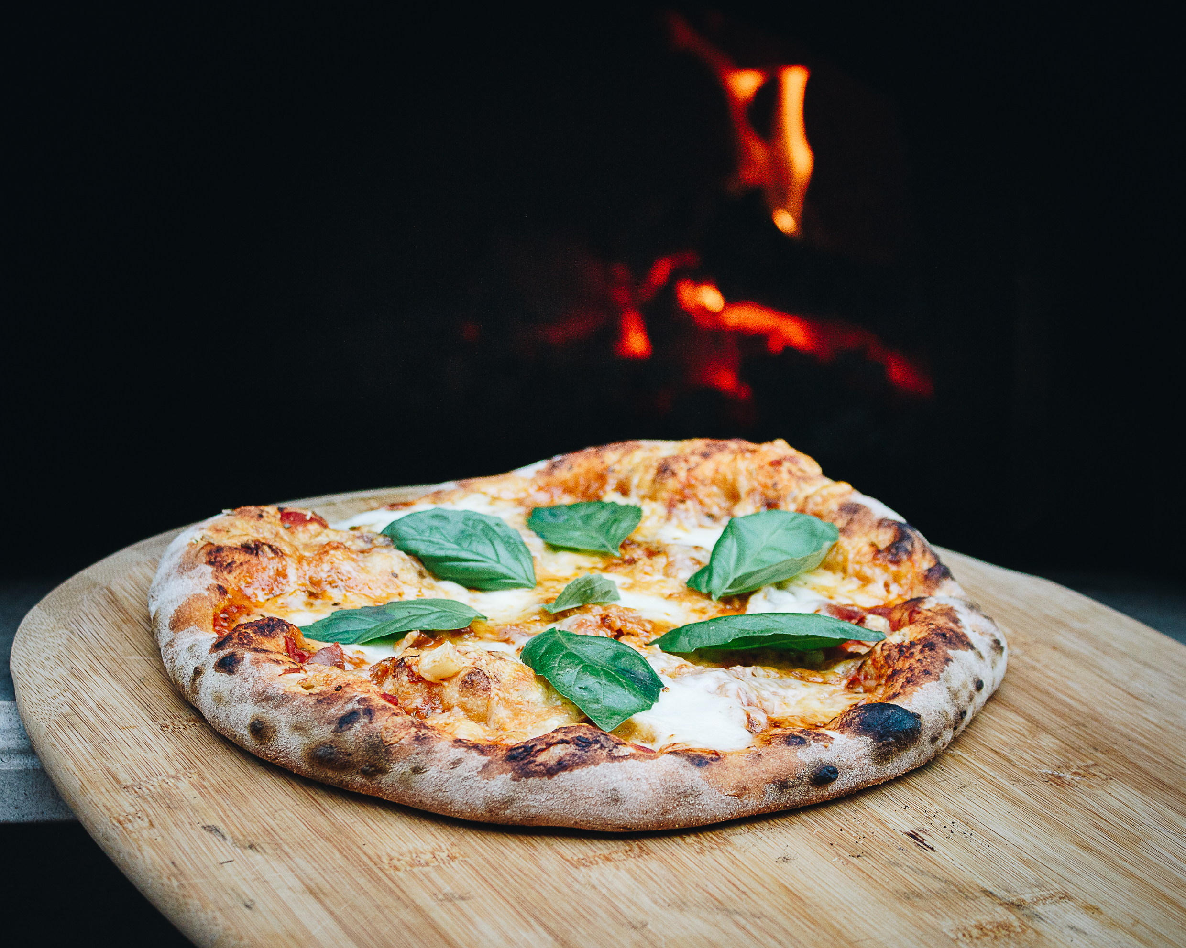
Ambiguity
I ate pizza with olives
I ate pizza with friends

Slide 13
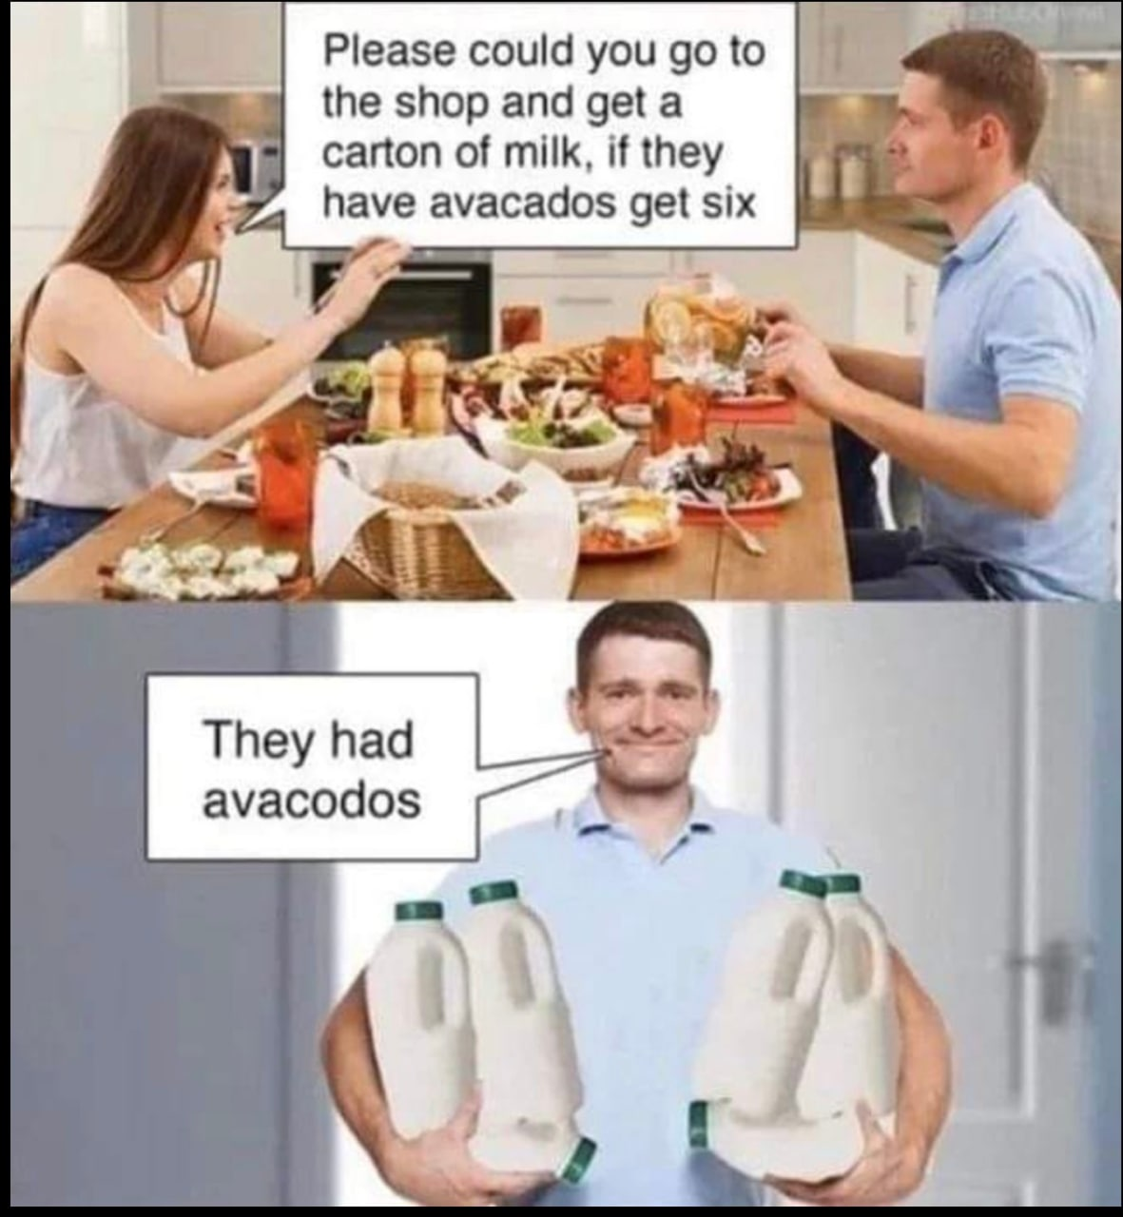
Ambiguity
I saw a girl playing baseball with a bat

Slide 14
Where?
Sheldon: Name your price.
Amy: Kiss me where I’ve never been kissed before.
Sheldon: You mean like Salt Lake City?
Amy: Nevermind…

Slide 15
Extreme Ambiguity (Real Headlines!)
Scientists count whales from space
The pope's baby steps on gays
Girl hit by car in the hospital
Iraqi head seeks arms
Students get first hand job experience
Squad helps dog bite victim
Miners refuse to work after death
Stolen painting found by tree
Actor sent to jail for not finishing sentence
Ban on Nude Dancing on Governor's Desk
Stadium air conditioning fails — Fans protest
Kids Make Nutritious Snacks

Slide 16

Ambiguity + Restrictivity

Slide 17
Retrieval is Key

Slide 18
Large Language Models are Limited
Knowledge Cut-off
Hallucinations
Data Privacy / GDPR / HIPAA
Limited Context Window

Slide 19
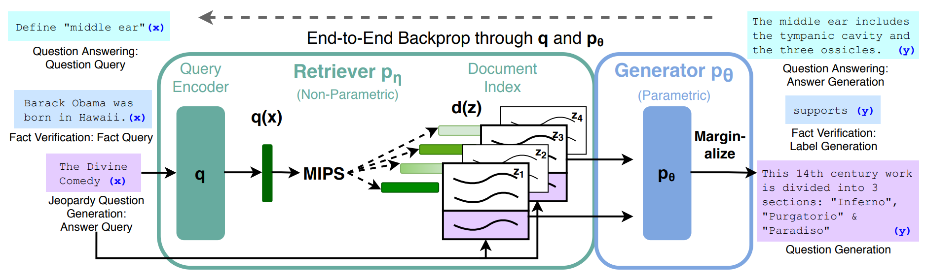
Retrieval-Augmented Generation (RAG) - 2021
[2005.11401] Retrieval-Augmented Generation for Knowledge-Intensive NLP Tasks

Slide 20
Retrieval Augmented Generation
Question Answering
Define: “middle ear”
Results
Results text are used in LLM Prompt to Generate Answer
Search Engine
Fact Verification
Barack Obama was born in Hawaii.
[2005.11401] Retrieval-Augmented Generation for Knowledge-Intensive NLP Tasks (arxiv.org)
Notes:
Many Existing Solutions: Llama-Index, Ragatulle, Vespa.AI, Cohere,…

Slide 21
Retrieval Augmented Generation
Search Engine
Question Answering
Documents
Define: “middle ear”
Integrated in the LLM Prompt
Prompt: “Answer [Input Query] based on this: [Context]
Fact Verification
Encoding +
Indexing
Query Encoder
Barack Obama was born in Hawaii.
Result
Candidates
Filtered
Retrieved Context
Indexed Retriever
Lookup 🔎
[2005.11401] Retrieval-Augmented Generation for Knowledge-Intensive NLP Tasks (arxiv.org)

Slide 22

IR Scheme
Query
Documents
Online
Offline
Representation Function
Transformation Function
Retrieval Model
Index
Comparison Function (lookup)
Result Candidates

Slide 23
RAG
Query
Documents
Online
Offline
Parser: Prompt to Query
Representation Function
Transformation Function
Prompt
Index
Retrieval Model
Comparison Function (lookup)
Response
LLM Summarizes Results
Result Candidates

Slide 24
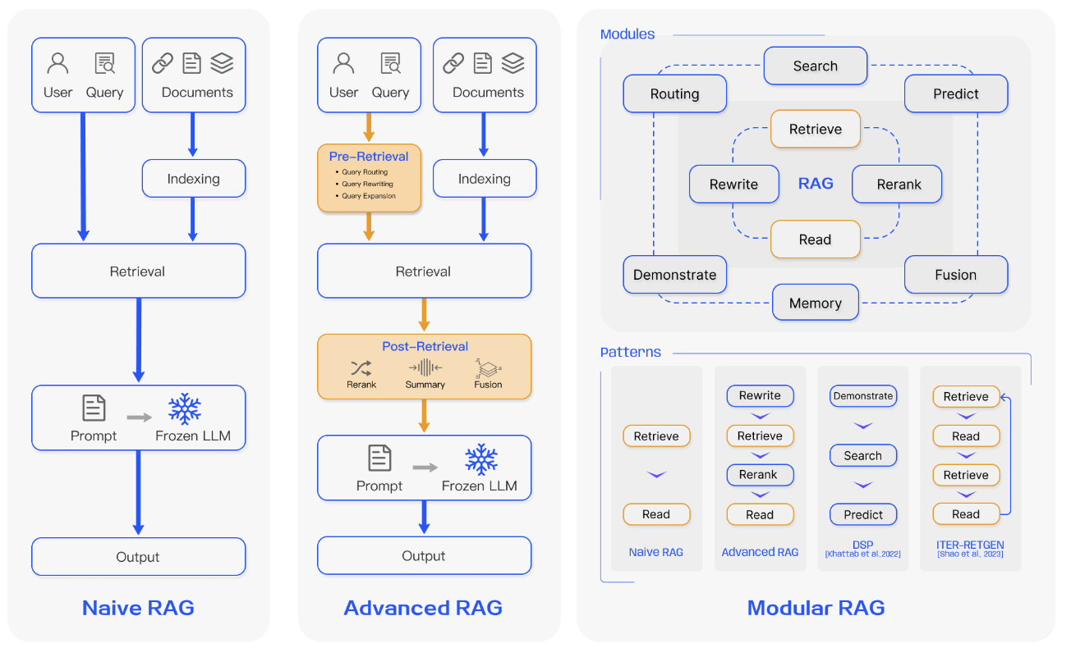
Retrieval-Augmented Generation (RAG) - Today

Slide 27
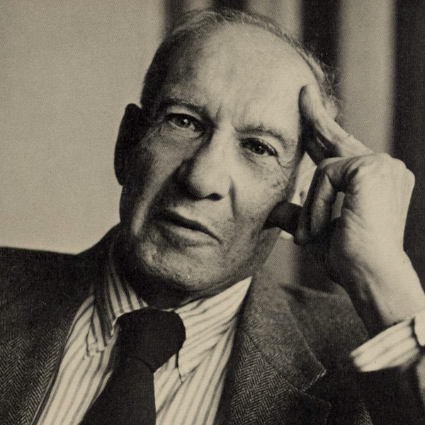
What gets measured gets done
Peter Drucker

Slide 28
What should we measure in retrieval systems?

Slide 29
Good Effectiveness Measures
Should capture some aspect of user satisfaction
Should be able to be replicated/reproduced
Should be comparable
E.g., a single number
Should have predictive values for other situations
Different queries on different document-collections

Slide 30
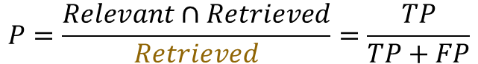
Precision
Precision: What fraction of the retrieved docs is relevant?
How good are the results?
Irrelevant | FP | TN
Relevant | TP | FN
 | Retrieved | Not retrieved
Retrieved Documents
Relevant Documents
$$P=\frac{Relevant∩Retrieved}{Retrieved}=\frac{TP}{TP+FP}$$

Slide 31
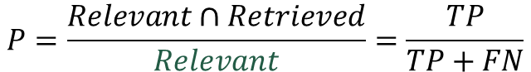
Recall
Recall: What fraction of the relevant documents is retrieved?
Did we forget anything?
Irrelevant | FP | TN
Relevant | TP | FN
 | Retrieved | Not retrieved
Retrieved Documents
Relevant Documents
$$P=\frac{Relevant∩Retrieved}{Relevant}=\frac{TP}{TP+FN}$$

Slide 32
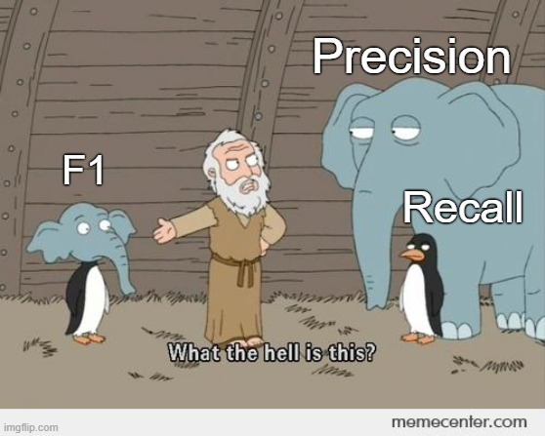
F1-Score

Slide 33
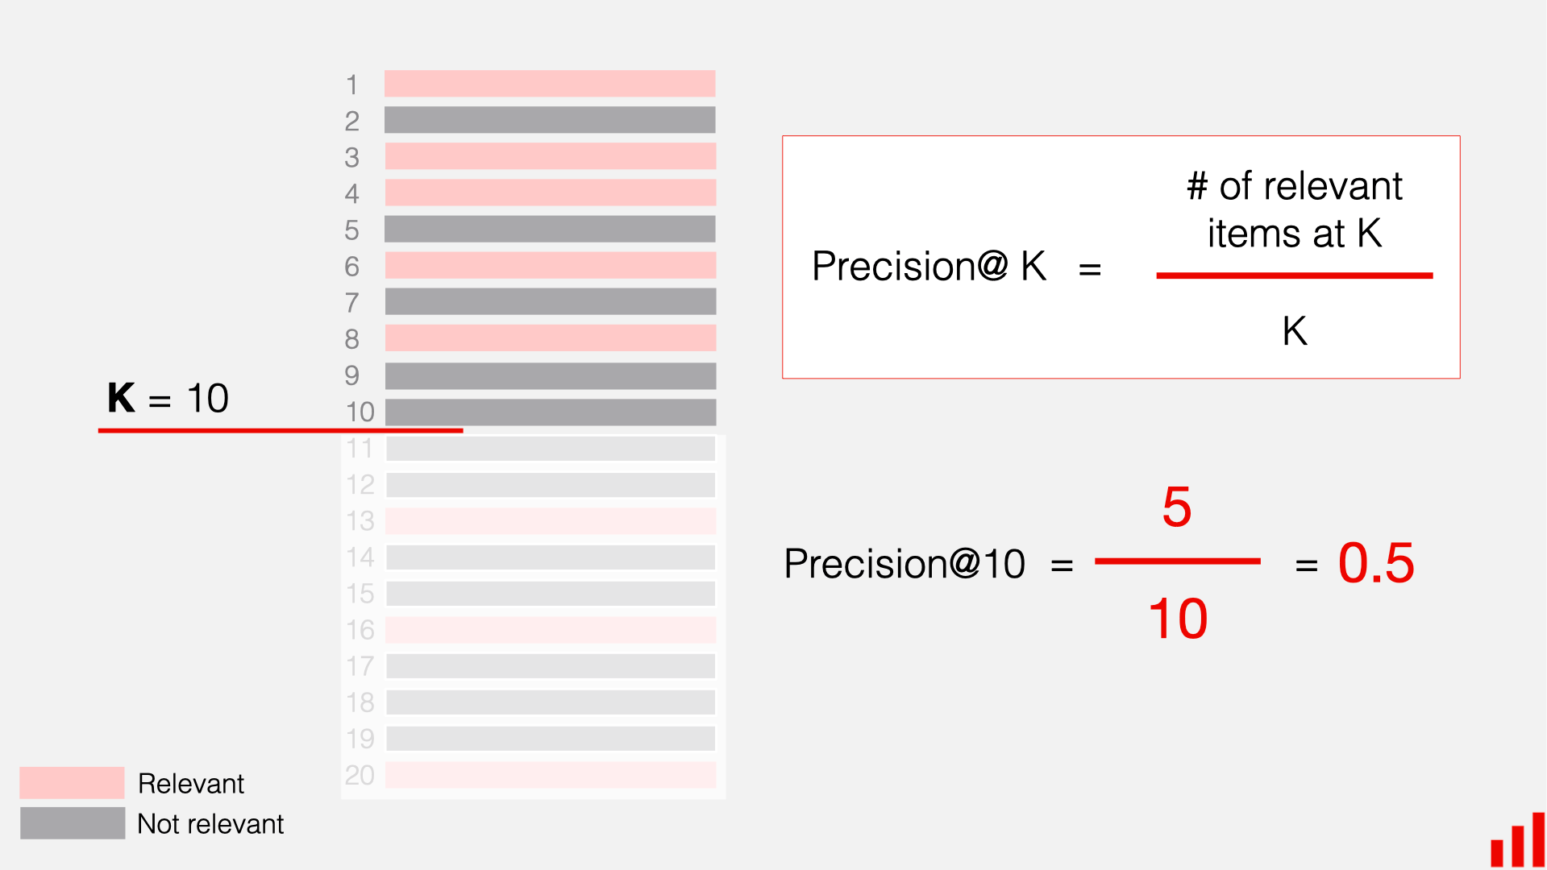
Precision@k

Slide 34
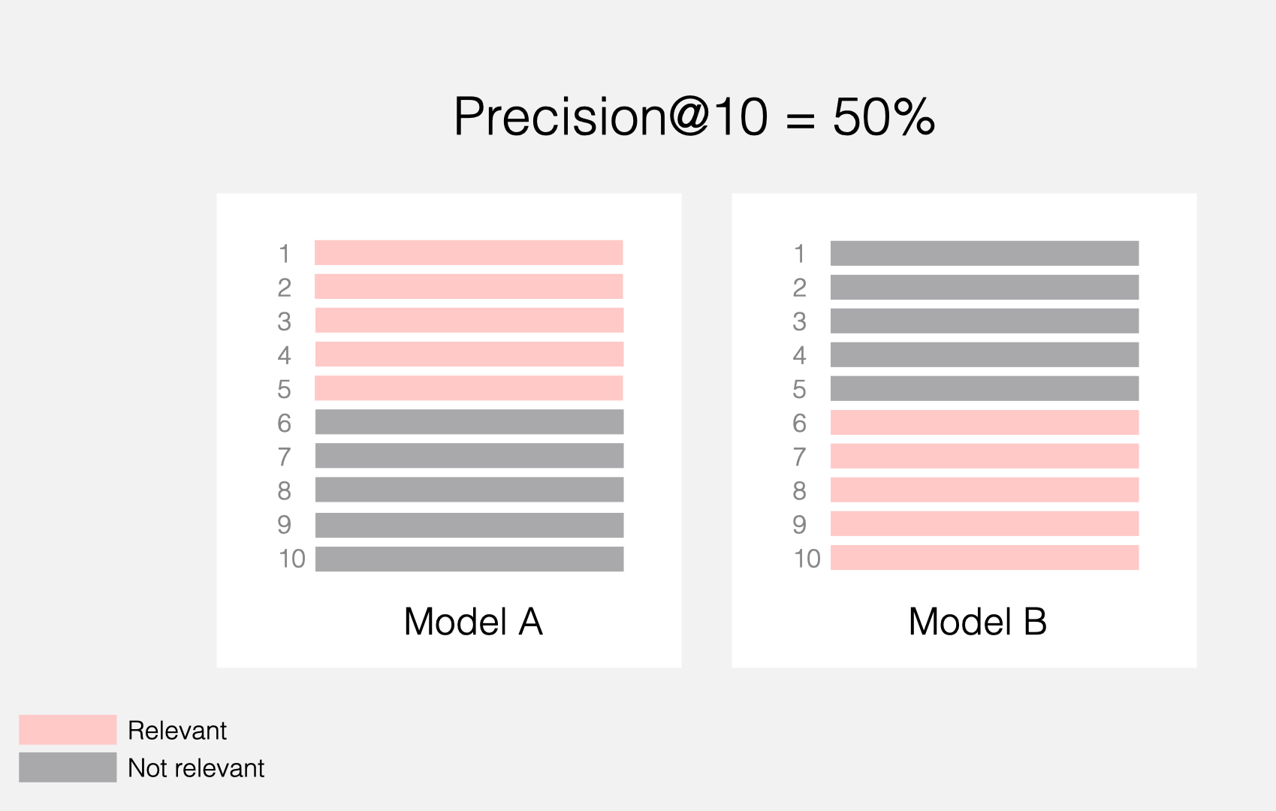
Precision@k – not so precise after all!
?

Slide 35
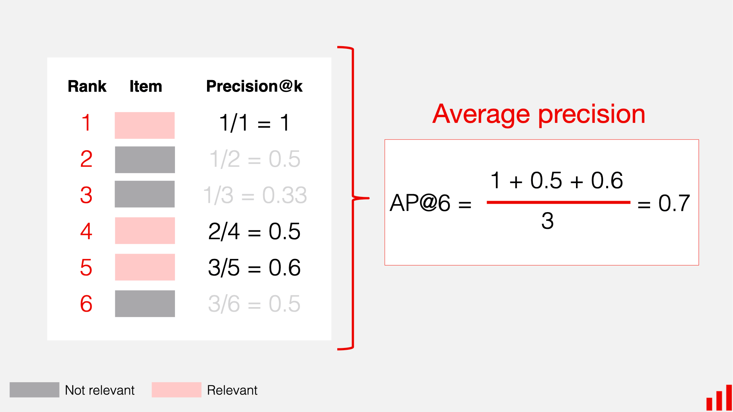
Mean Average Precision (MAP)

Slide 36
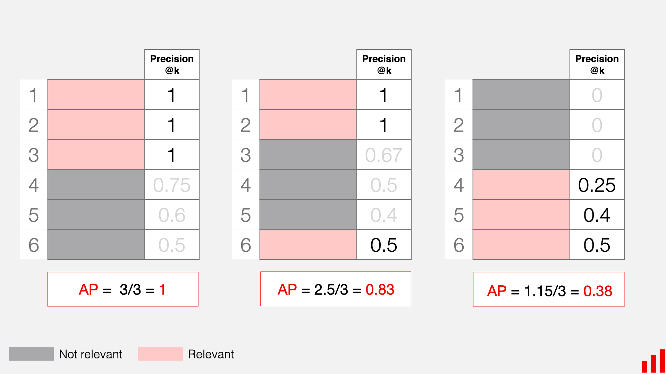
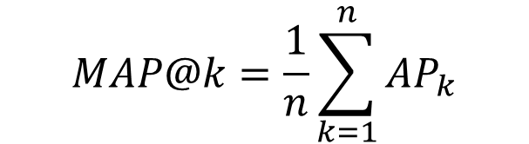
MAP in Action
$$MAP@k=\frac{1}{n}\sum_{k=1}^{n}{AP_{k}}$$

Slide 37
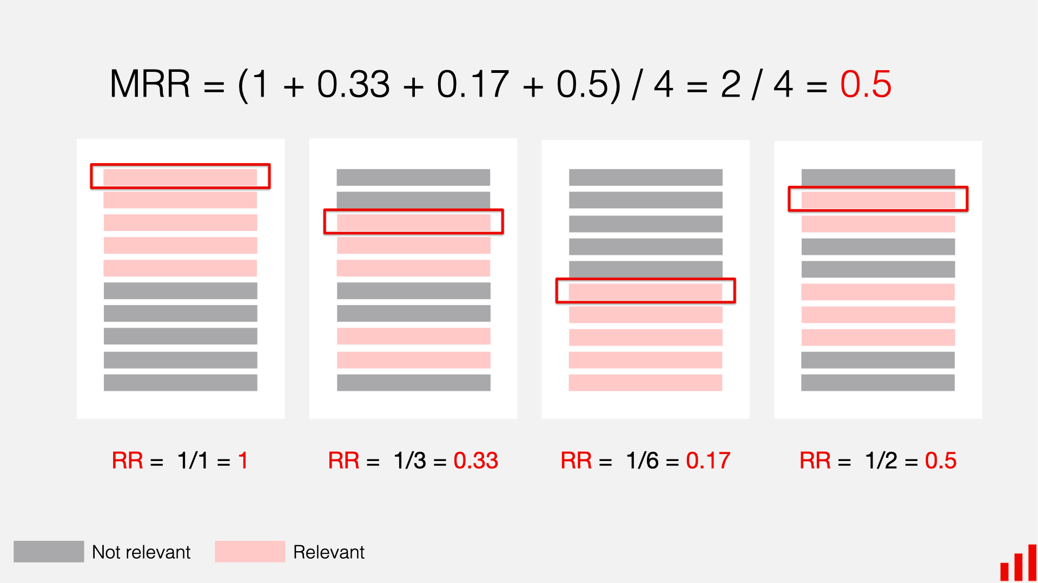
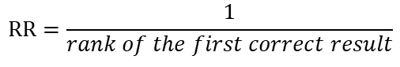
Mean Reciprocal Rank (MRR)
$$RR=\frac{1}{rank of the first correct result}$$

Slide 38
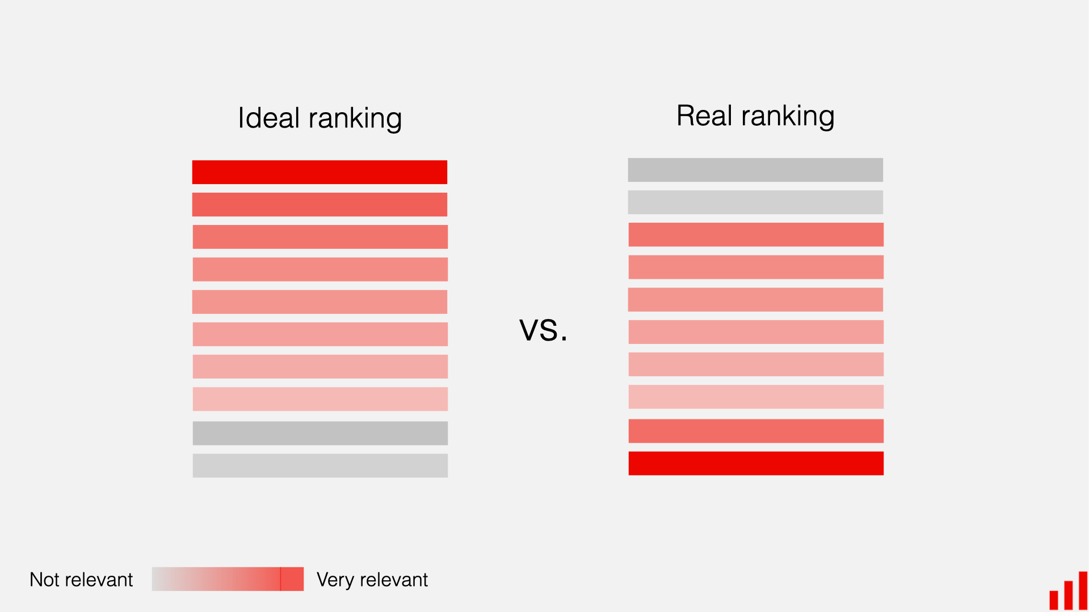
Normalized Discounted Cumulative Gain (nDCG)

Slide 39
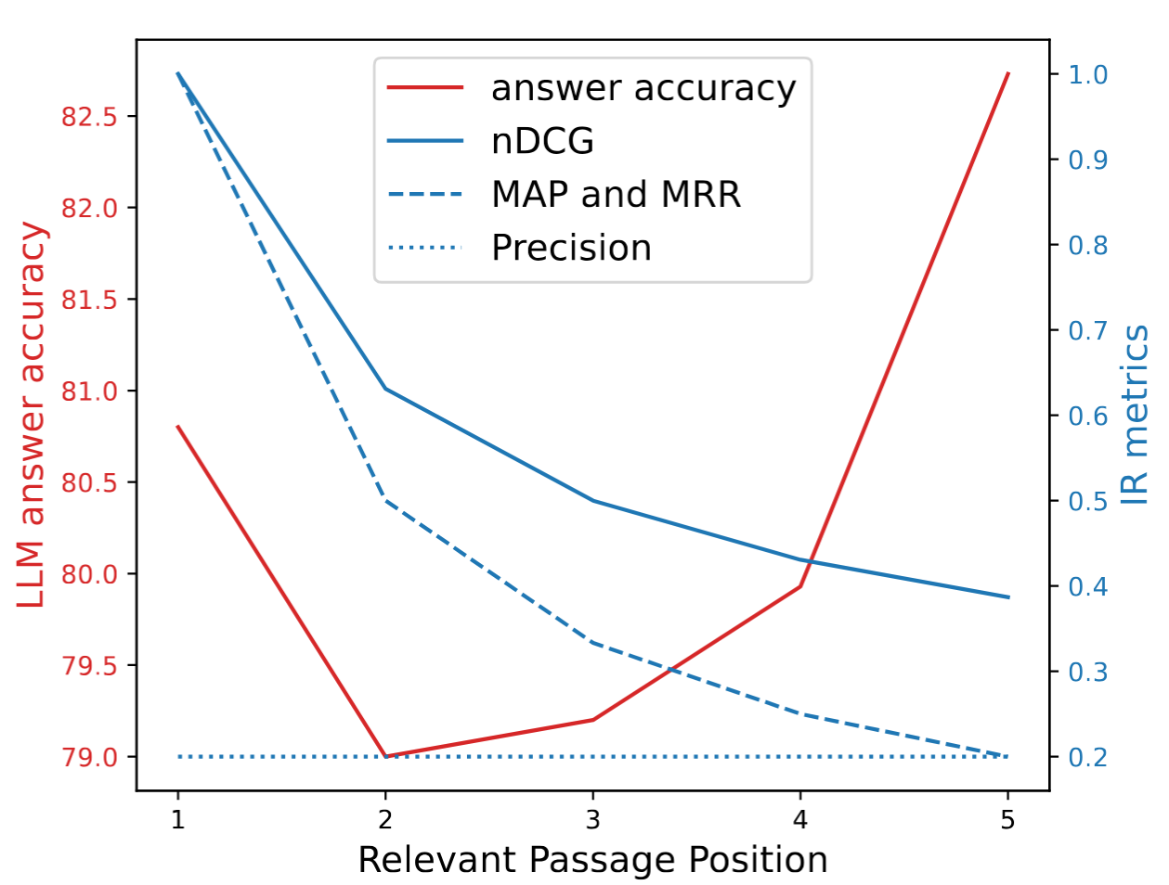
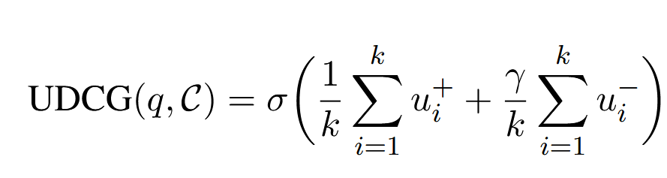
Evaluation Results Metrics – for Humans, not for LLMs
Utility and Distraction-aware
Cumulative Gain (UDCG):
Precision is position-agnostic
[2510.21440] Redefining Retrieval Evaluation in the Era of LLMs
GiovanniTRA/UDCG: Code and Data of the paper: "Redefining Retrieval Evaluation in the Era of LLMs"

Slide 40
Evaluating Generative Responses

Slide 41
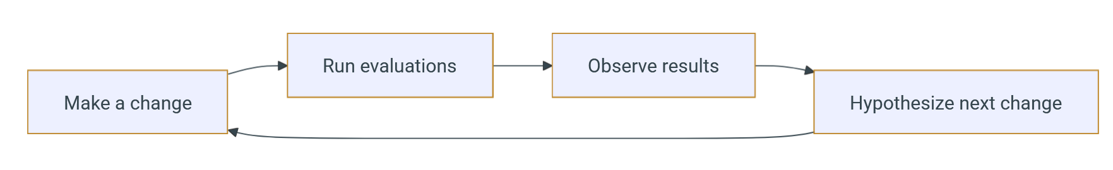
Evaluating RAG Output
vibrantlabsai/ragas: Supercharge Your LLM Application Evaluations 🚀 (Open-Source!)
OpenLIT | OpenTelemetry-native GenAI and LLM Application Observability (Open-Source!)
Langfuse
Helicone / AI Gateway & LLM Observability
Laminar
Traceloop - LLM Reliability Platform
embeddings-benchmark/mteb: MTEB: Massive Text Embedding Benchmark

Slide 42
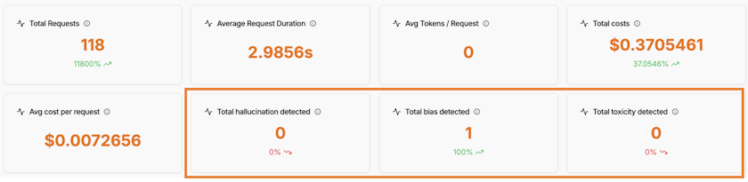
Evaluating RAG Output
Keyword detection
LLM-as-a-Judge
Toxicity & Bias detection

Slide 43
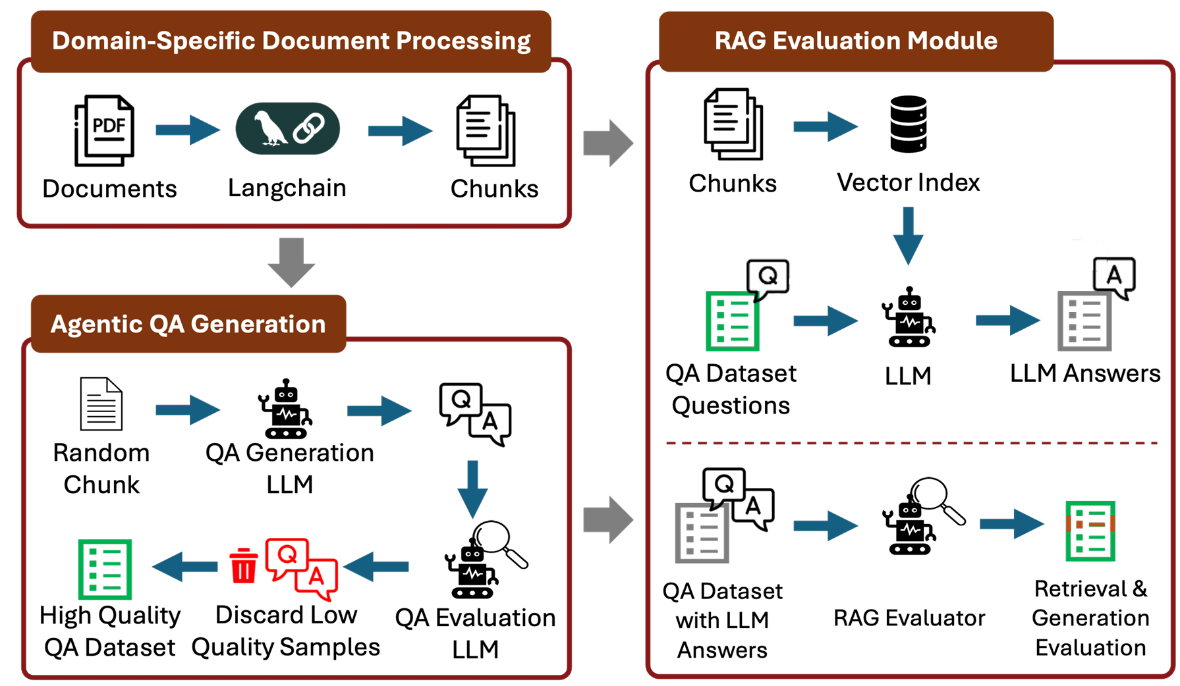
RAGalyst
[2511.04502] RAGalyst: Automated Human-Aligned Agentic Evaluation for Domain-Specific RAG
Notes:
LLM produces synthetic question–answer context datasets

